Slide 1
TEXT TO IMAGE GENERATOR
TEAM MEMBERS:
ANAGHA ANOOP (12)
ARUSHA N S (17)
JENI M ROSE (26)
REVATHY DR (38)

Slide 2
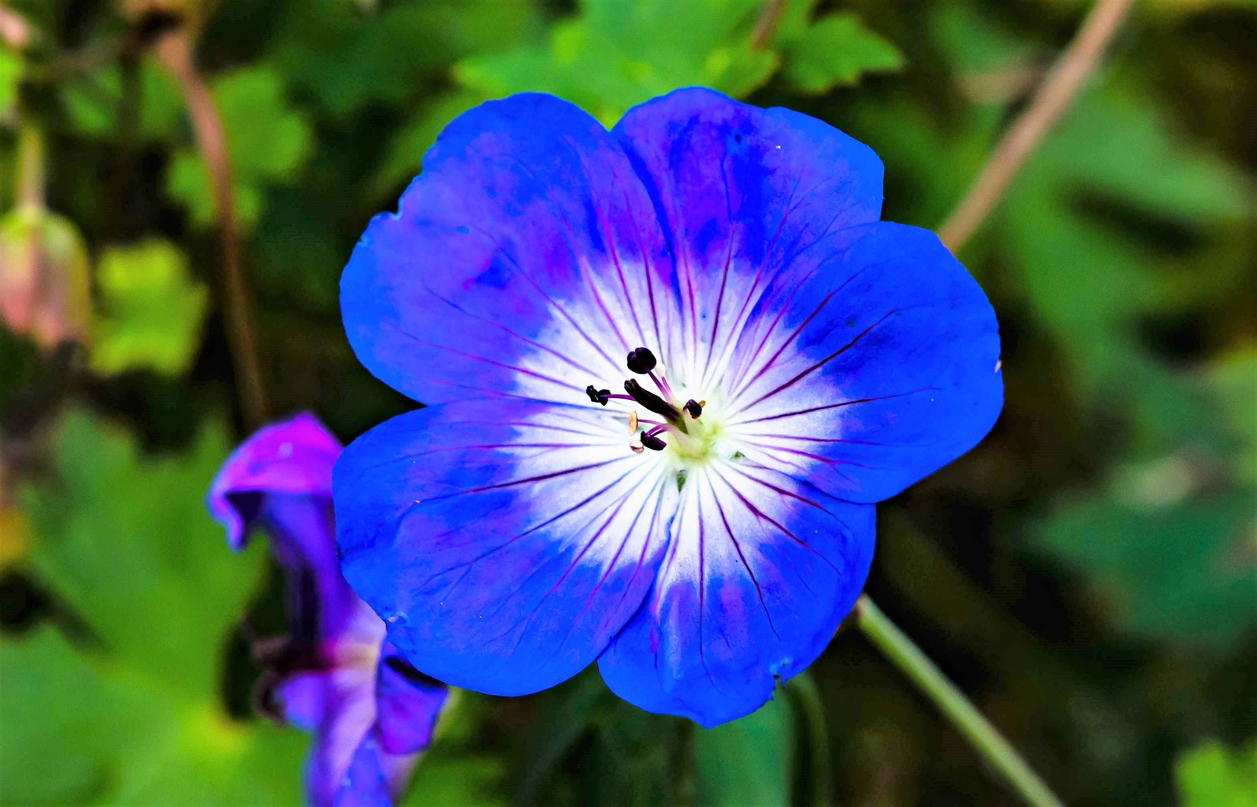
Introduction
For a human mind it is very easy to think of new content. what if someone asks you to “draw a flower with blue petals”. It is very easy for us to do that. But machines process information very differently. GANs are a kind of architecture in Deep learning that can produce content from random noise. Our app aim to generate images based on the flower dataset.

Slide 3
Abstract
Synthetic content generation using machines is a very trending topic in the field of Deep Learning and it is an extremely difficult task even for the state-of-the-Art ML algorithms.
In the recent past Generative Adversarial Networks (GAN) have shown great promise when it comes to generating images but they are difficult to train and condition on any particular input which acts as a downside for them.
However, they have tremendous applications in generating content in an unsupervised learning approach like generating video, Increasing the resolution of Images or Generating Images from Text.
In this project we look at generating 64*64 Images on the fly using a text as an input.
The final project will be a web-app, where, you can input a text and a synthetic Image Will be generated based on the description of the text.

Slide 4

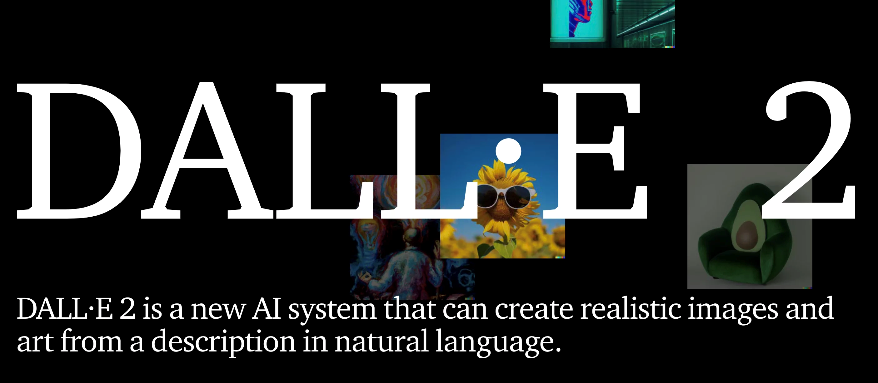
Existing System
As of our latest update there are many existing systems of similar kind. Some of the prominent ones are given below:
These existing systems can serve as valuable references and inspirations for our project on developing an app for medicinal herb identification.

Slide 5
Drawbacks
Time-Consuming Processes
Traditional image creation methods are time-consuming and often result in bottlenecks, limiting the rate of production and innovation in dynamic environments.
Resource Intensity
Manpower and financial resources are significantly taxed, as each image requires individual attention, from concept to execution, demanding a high level of input for a relatively slow output.
Reproducibility Issues
Reproducing the same level of quality across different instances can be challenging, and variations can lead to inconsistencies, affecting brand image and user experience.

Slide 6
Proposed system
Automated Generation
We propose a system powered by GANs which automates the generation of images, revolutionizing the content creation process through algorithms that learn and ideate autonomously.
Enhanced Creativity
The algorithmic approach opens avenues for enhanced creativity, as the AI can explore design possibilities beyond human imagination, guided by data trends and patterns.
Scalability and Speed
Our system boasts unprecedented scalability and speed, offering the capability to produce a multitude of high-quality images swiftly, thus meeting the demands of modern-day production needs.

Slide 7
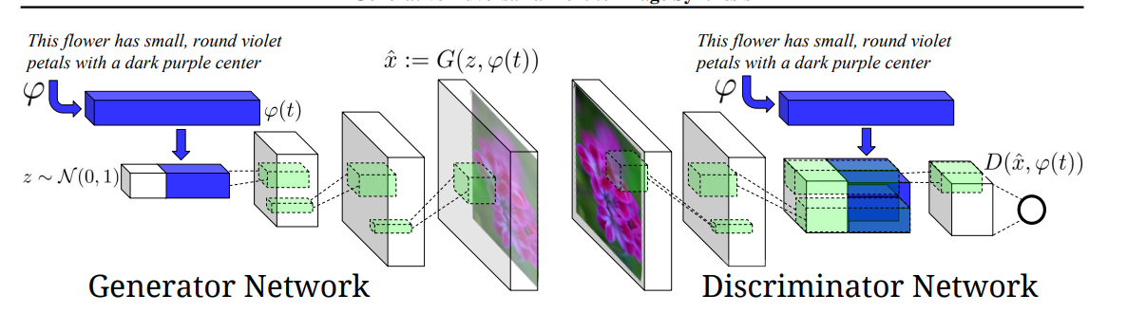
Architecture

Slide 8
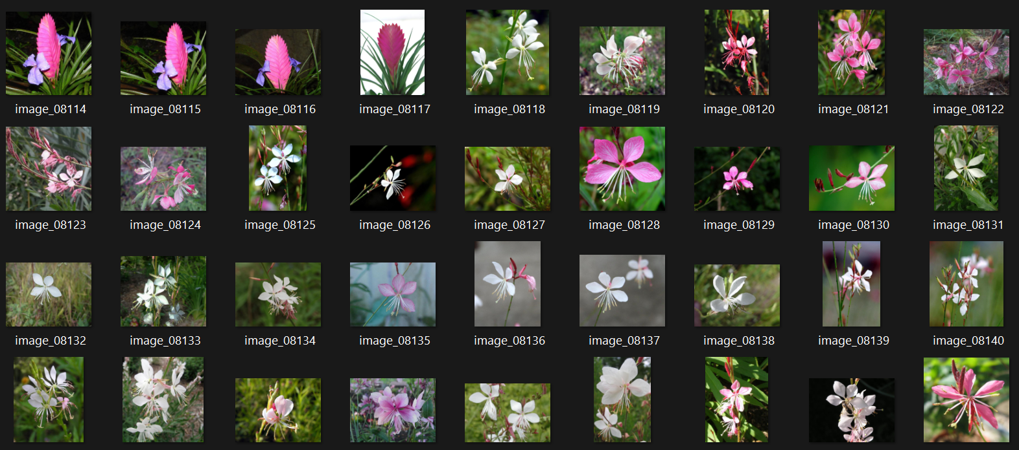
Dataset
Oxford 102 Flower is an image classification dataset consisting of 102 flower categories. The flowers chosen to be flower commonly occurring in the United Kingdom. Each class consists of between 40 and 258 images.

Slide 9
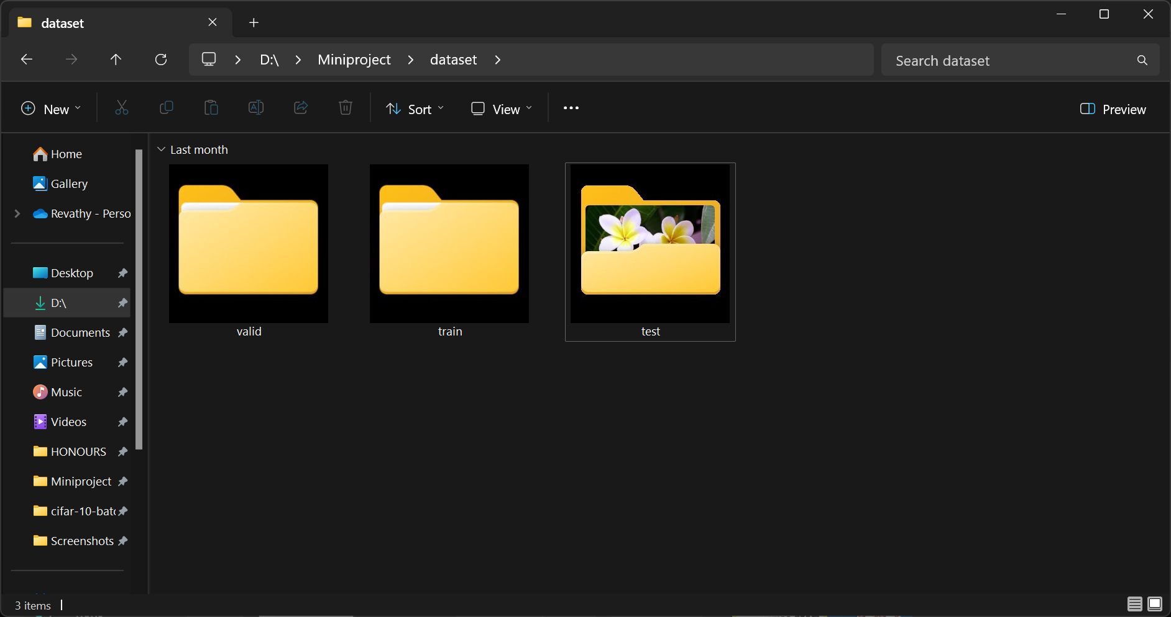
Reading Testing Images
We divided this dataset into training, validation and test images of each classes in the datasets for further training.

Slide 10
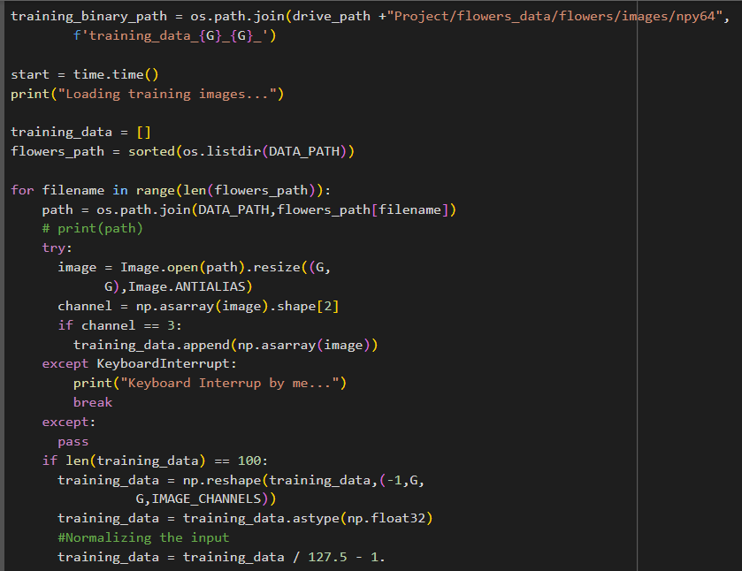
Image Preprocessing

Slide 11
Tools Required
Computational Resources
High-powered GPUs and robust computational infrastructures are essential to provide the tremendous processing power required for training GANs effectively.
Data
A vast dataset of images is necessary as input for the GAN's learning process, helping the AI understand and generate a diverse range of visual content.
Software Frameworks
Advanced software frameworks, such as TensorFlow are imperative for building and refining GAN models, providing a flexible and powerful backbone for our system.

Slide 12
Conclusion
Advancements
The advancements in GAN-based text-to-image generation hold promise for various creative applications.
Potential
This technology has the potential to transform digital art, content creation, and visual storytelling.
Future Scope
The intersection of AI and art has vast possibilities, shaping the future of visual media creation.

Slide 13
Reference
[1] Reed, S., et al. (2016). Generative Adversarial Text-to-Image Synthesis. arXiv:1605.05396.
[2] Mirza, M., & Osindero, S. (2014). Conditional Generative Adversarial Nets. arXiv:1411.1784.
[3] Vinyals, O., et al. (2015). Show and Tell: A Neural Image Caption Generator. CVPR.
[4] Karras, T., et al. (2018). Progressive Growing of GANs for Improved Quality, Stability, and Variation. ICLR.
[5] Kiros, R., et al. (2014). Unifying Visual-Semantic Embeddings with Multimodal Neural Language Models. arXiv:1411.2539.
[6] Zhu, J. Y., et al. (2019). Towards High-Resolution Image Synthesis with Progressive Growing of GANs. ICLR.

Slide 14
THANK YOU !

